Slide 1
Casting Methods: Investment Casting
Lecture 7

Slide 2
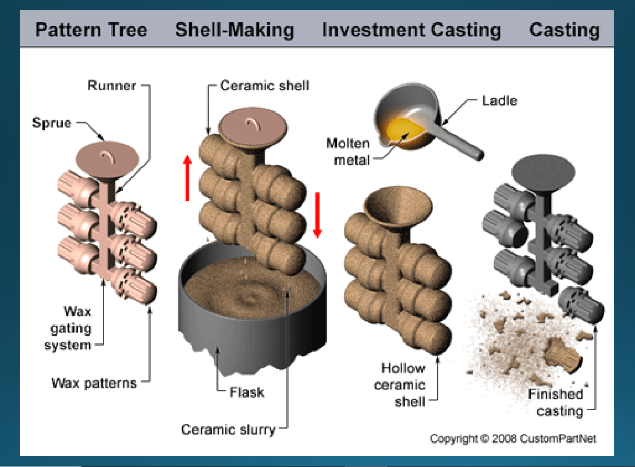
Investment casting

Slide 3
Investment casting
Investment casting requires the use of a metal die, wax, ceramic slurry, furnace, molten metal, and any machines needed for sandblasting, cutting, or grinding.
Investment casting, also known as lost-wax casting, is a versatile manufacturing process used across numerous industries to create intricate, high-precision parts. It is particularly well-suited for applications requiring complex geometries, tight tolerances, and smooth surface finishes.

Slide 4
Investment casting: Process
The process steps include the following:
Pattern creation: The wax patterns are typically injection molded into a metal die and are formed as one piece and some time special designs made. Cores may be used to form any internal features on the pattern.
Mold creation: This "pattern tree" is dipped into a slurry of fine ceramic
particles, coated with more coarse particles, and then dried to form a ceramic shell around the patterns and gating system. This process is repeated until the shell is thick enough to withstand the pressure of molten metal it will encounter.

Slide 5
Investment casting: Process
Lost wax: The shell is then placed into an oven and the wax is melted out leaving a hollow ceramic shell that acts as a one-piece mold, hence the name "lost wax" casting.
Pouring: The mold is preheated in a furnace to approximately 1000°C (1832°F) and the molten metal is poured from a ladle into the gating system of the mold, filling the mold cavity..
Cooling: After the mold has been filled, the molten metal is allowed to cool and solidify into the shape of the final casting. Cooling time depends on the thickness of the part, thickness of the mold, and the material used.

Slide 6
Investment casting: Process
Casting removal: After the molten metal has cooled, the mold can be broken and the casting removed. The ceramic mold is typically broken using water jets, but several other methods also used. Once removed, the parts are separated from the gating system by either sawing, grinding or cold breaking (using liquid nitrogen).
Finishing: Often times, finishing operations such as grinding or sandblasting are used to smooth the part at the gates. Heat treatment is also sometimes used to harden the final part.

Slide 7
Investment casting: Shapes
Thin-walled: Complex shapes
Solid: Cylindrical
Solid: Cubic
Solid: Complex shapes
Thin-walled: Cylindrical
Thin-walled: Cubic

Slide 8
Investment casting: Materials
Part size: Weight: 0.02 oz - 500 lb
Materials:
Alloy Steel Carbon Steel
Stainless Steel Aluminum
Copper Nickel
Cast Iron Lead
Magnesium Tin
Titanium Zinc

Slide 9


